Slide 1
Math Resource Centers
Leading Tickles Primary

Slide 2
A Little Background…
Team Members:
Krista Buckley
Jami Molloy
Candace Sacrey (secretary)
Leading Tickles Primary:
K-3 multi-age school
8 children: three Kindergartens, two grade ones and three grade 3’s.

Slide 3
The Focus of our Project…
To explore if student engagement increased as a result of the implementation of Math Resource Centers.
How was our Focus Area chosen?
When reviewing student achievement data we identified an area of weakness and realized we needed to make adjustments to our instruction.
Our Most VALUABLE Resource: Our children!

Slide 4
Research Questions:
Student Questions:
How can center based learning support our students and increase levels of engagement?
How can center based learning increase critical thinking skills in our students?
Teacher Question:
Has inquiry based teaching practices improved our classroom dynamic?

Slide 5
Ethical Considerations… * At our curriculum night parents were informed of our project. * Prior to the start of our project the informed consent forms were sent home and signed by all of our parents. * Parents are very involved in our school and encouraged to be a part of everything we do.

Slide 6
The Planning Stages…
* During the planning stages we made a lot of mistakes and wasted a lot of time. Oops! What was beneficial was the opportunities to access professional learning materials and the gift of time to reflect on our learning. Also collaboration is difficult to do when there is no common planning time available. This was a bonus to being involved in this project.
*What was important to recognize is that plans do not always work out. What’s important is turning failures into something positive and the response.
*Some of our most useful resources were: our students, Tom, collaboration with ourselves and others and professional reading/viewing.

Slide 7
Implementation
Behavioral expectation were made clear: Students played a part in coming up with the rules and know what is expected during center time.
Implement: carried out the centers
Ongoing assessment
Reflection: This proved to be key to success
Responsive teaching: Adjustments made to improve centers for next time and tailored to individual student needs. Address teachable moments.

Slide 8
Some sample centers…
Estimation station
Challenge Center
Pattern blocks
Your turn to explore! ☺

Slide 9
Data Collection/Analysis
Interviews
Artifacts
Observations
Student feedback
Conferencing

Slide 10
Results
“I found myself completely changing the way I teach… across every subject area. “- Krista Buckley
Students said things such as
“Miss, can we have math now?” – grade 3
“This is easy, figuring things out”- grade 3
“ I only liked working in my book one time”- grade 1
Observed behavior
** Less interrupting
** Students driven to complete challenges- even during recess and lunch time.
** Student feedback is positive

Slide 11
Results continued…
“This is my first time teaching K-3 Math curriculum, I will definitely take what I learned from this project and apply it to my future classroom”- Jami Molloy
The answer to our research questions: Yes! Children were engaged and are now critical thinkers that can adapt to authentic situations.

Slide 12
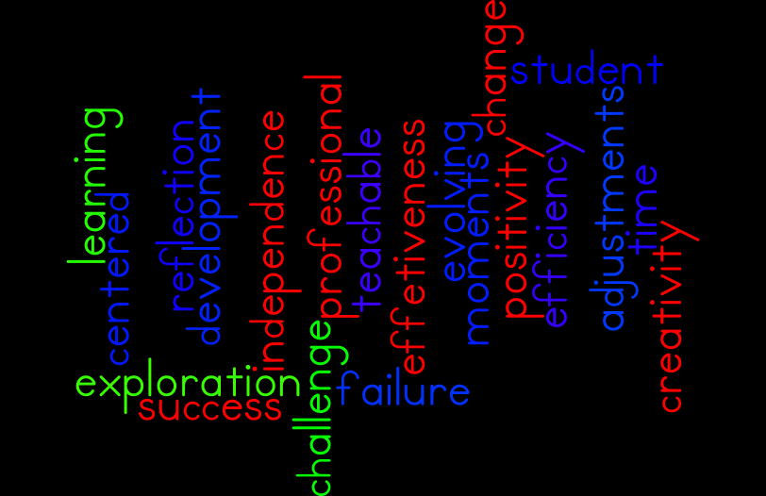
Teacher Inquiry…

Slide 13
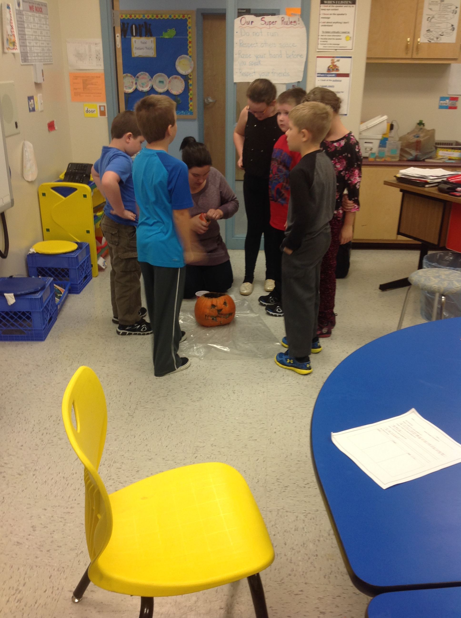
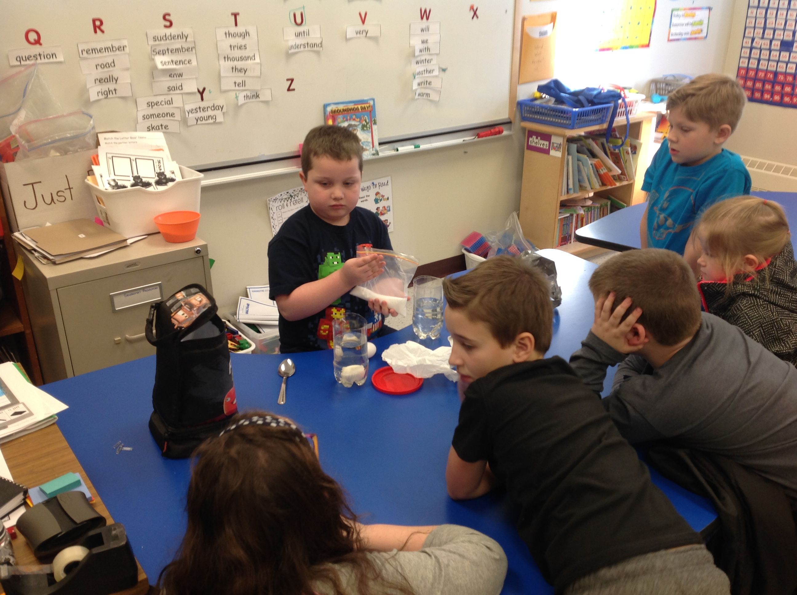
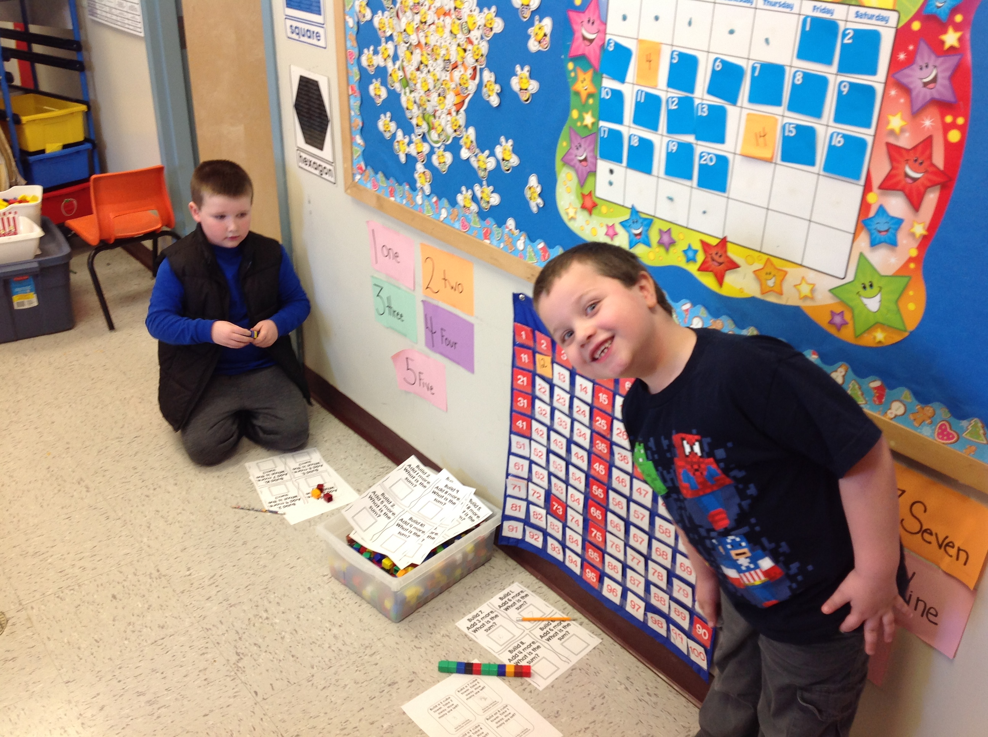
Was this project successful??

Slide 14
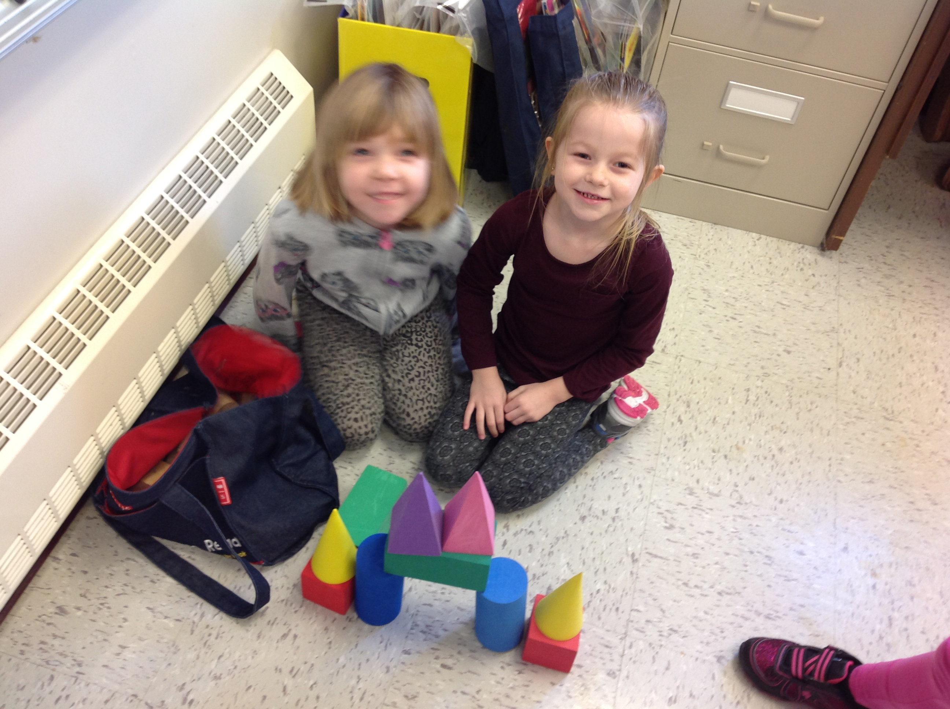
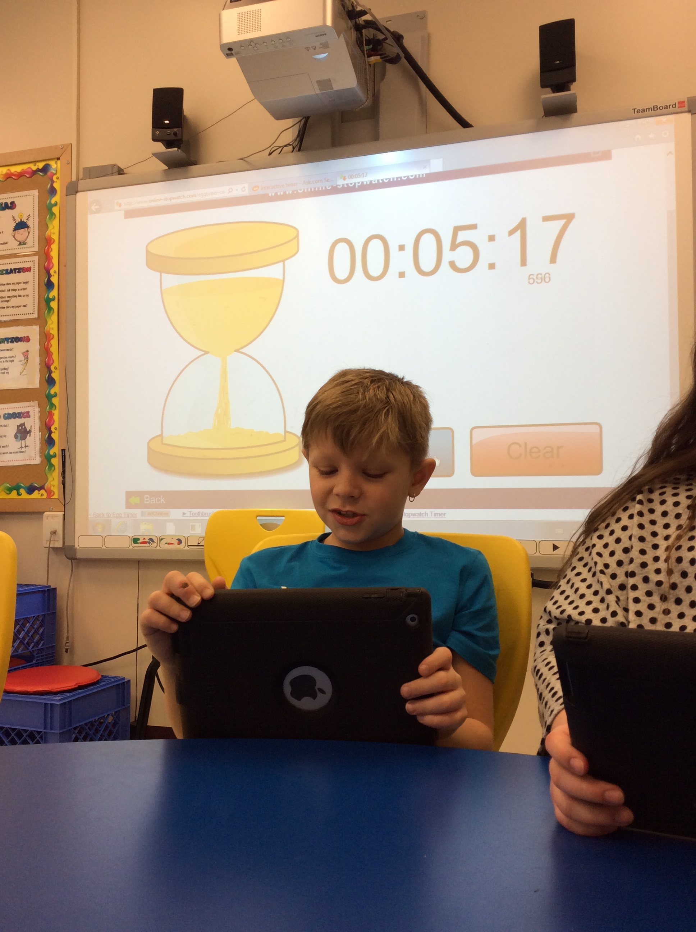
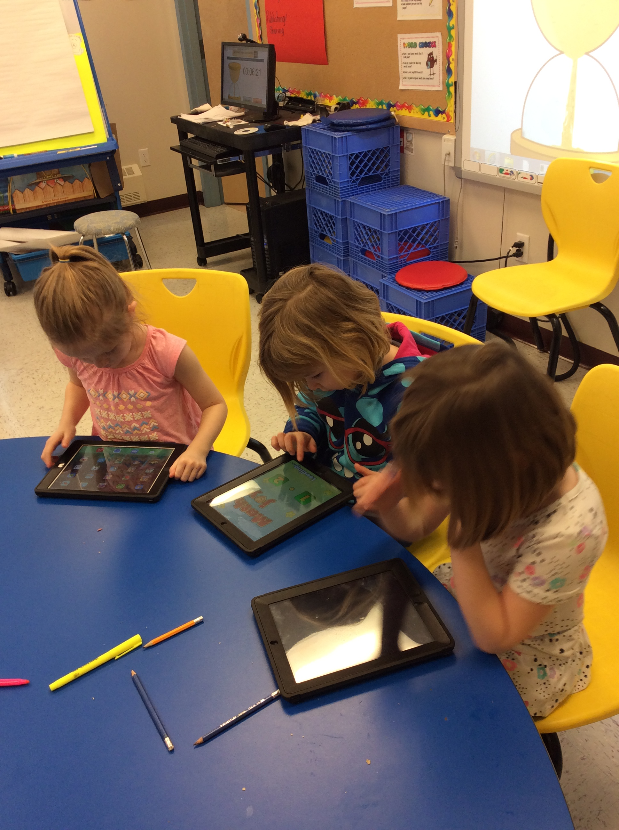

Slide 15
This project was very successful… * We found evidence that student engagement increased. * Students loved Math and were excited about it. * Students developed critical thinking skills. * As teachers we found ourselves changing the way we think about learning and in turn our classrooms became more student centered. Teaching changed across all curriculum areas as a result of the positive experiences we saw students having.

Slide 16
Some challenges we Faced
There are a lot of “cute” math centers out there and we found ourselves getting caught up and wasting time. Really it caused us to loose focus.
We responded and got back on track.
Hard to relinquish control of the classroom and let students take it to where they wanted to go
Multi grade planning is time consuming

Slide 17
Any Questions??
“Give a man a fish and you feed him for a day; teach a man to fish and you feed him for a lifetime.”
-Maimonide
The same can be said for children and their learning. When we create an atmosphere for learning where students are responsible and a big part of taking their learning where they want it to go it becomes more memorable for them. They learn how to learn instead of just learning “stuff”.

